Slide 1
UNIVERSITY STUDENT DATABASE

Slide 2
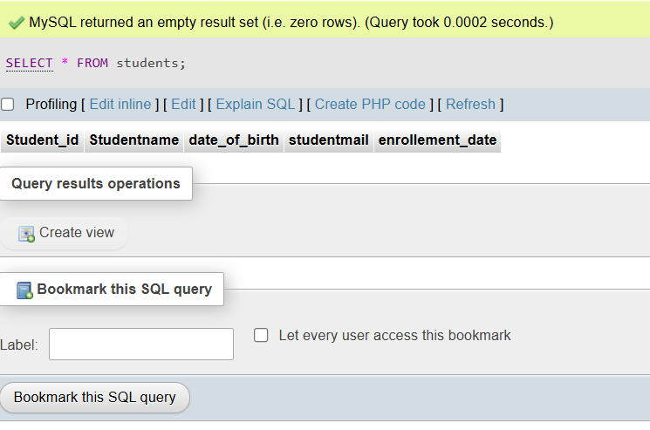
TABLE:Students
CREATE TABLE Students(
Student_id INT PRIMARY Key,
Studentname VARCHAR(20),
date_of_birth DATE,
studentmail VARCHAR(50),
enrollement_date DATE
);
SELECT * FROM students

Slide 3
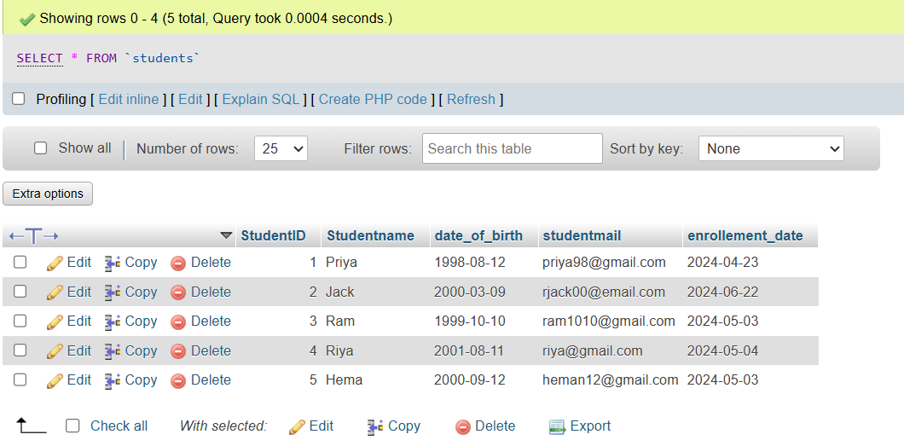
INSERT INTO Students (`student_id`, `Studentname`, `date_of_birth`, `studentmail`, `enrollment_date`)
VALUES (1, 'Priya', '1998-08-12', 'priya98@gmail.com', '2024-04-23'),
(2, 'Jack', '2000-03-09', 'rjack00@email.com', '2024-06-22'),
(3, 'Ram', '1999-10-10', 'ram1010@gmail.com', '2024-05-03'),
(4, 'Riya', '2001-08-11', 'riya@gmail.com', '2024-05-04'),
(5, 'Hema', '2000-09-12', 'heman12@gmail.com', '2024-05-03’);

Slide 4
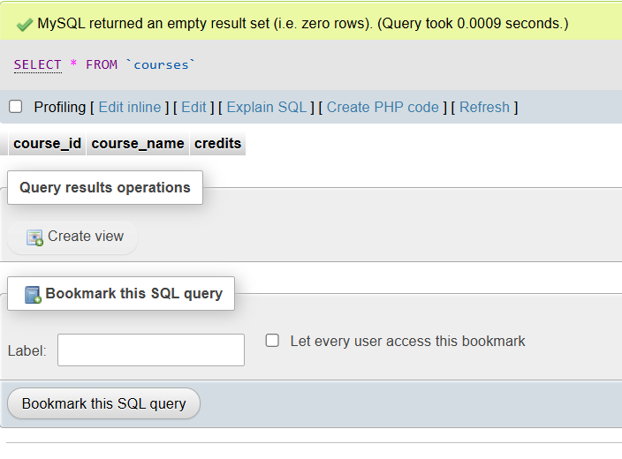
TABLE: Courses
CREATE TABLE Courses(
course_id INT PRIMARY KEY,
course_name VARCHAR(20),
credits INT
);

Slide 5
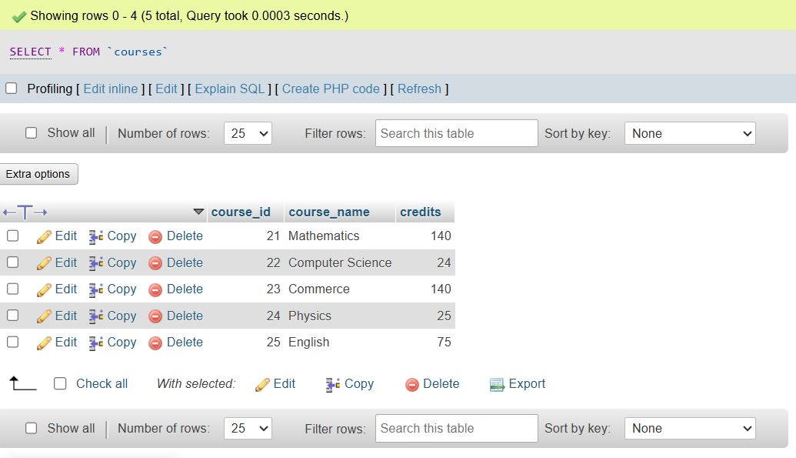
INSERT INTO courses (`course_id`,`course_name`,`credits`)
VALUES (21, 'Mathematics', 140),
(22, 'Computer Science', 24),
(23, 'Commerce', 140),
(24, 'Physics', 25),
(25, 'English', 75);

Slide 6
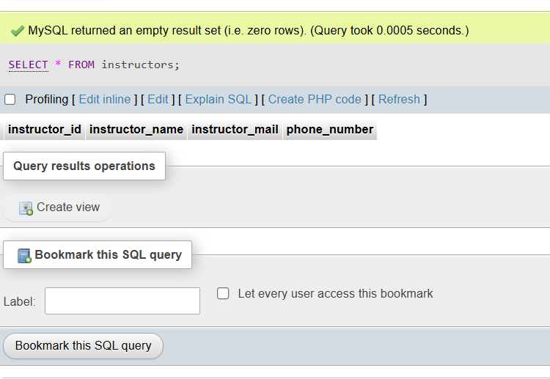
TABLE: Instructors
CREATE TABLE Instructors(
instructor_id INT Primary Key,
instructor_name VARCHAR(50),
instructor_mail VARCHAR(50),
phone_number VARCHAR(20)
);

Slide 7
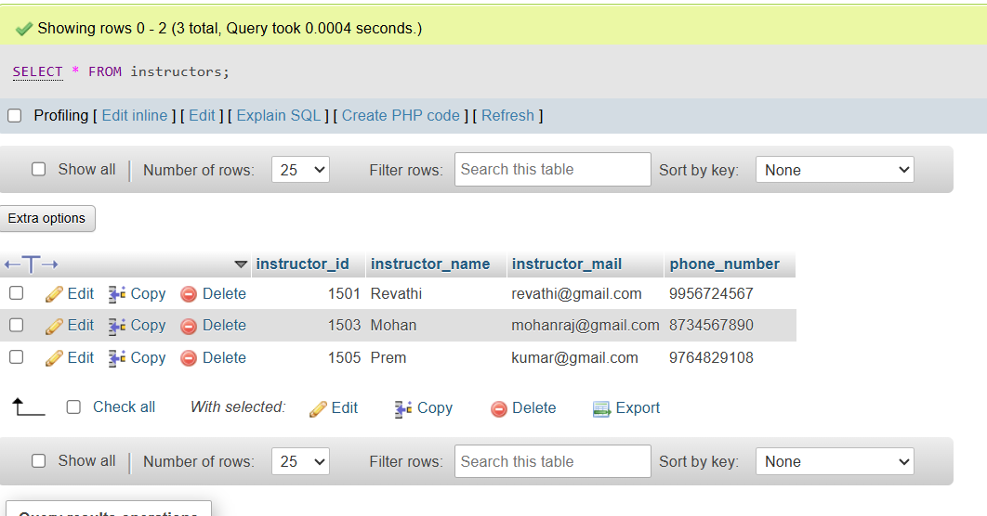
INSERT INTO instructors (`instructor_id`,`instructor_name`,`instructor_mail`,`phone_number`)
VALUES (1501, 'Revathi’ , 'revathi@gmail.com', '9956724567'),
(1503, 'Mohan', 'mohanraj@gmail.com', '8734567890'),
(1505, 'Prem', 'kumar@gmail.com', '9764829108');

Slide 8
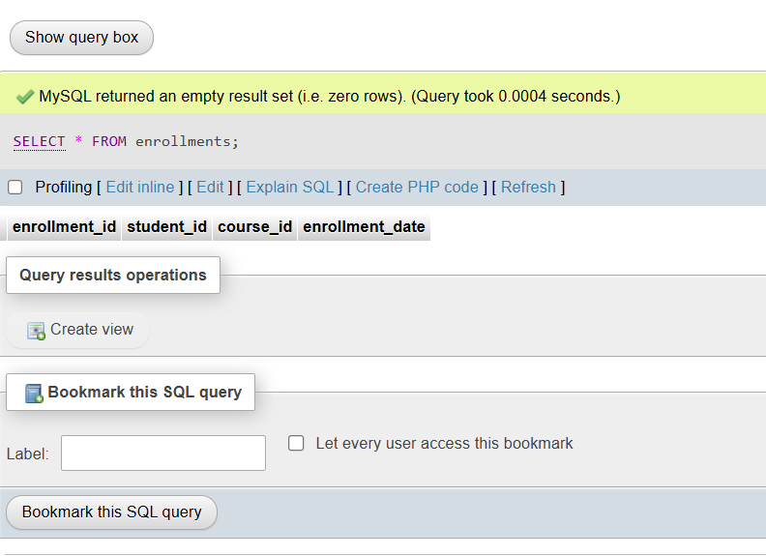
TABLE: Enrollments
CREATE TABLE Enrollments (
enrollment_id INT PRIMARY KEY,
student_id INT,
course_id INT,
enrollment_date DATE
);

Slide 9
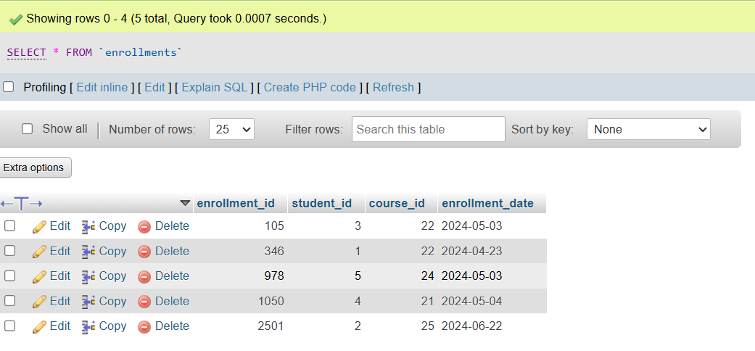
INSERT INTO enrollments(`enrollment_id`,`student_id`,`course_id`,`enrollment_date`)
VALUES (346, 1, 22, '2024-04-23'),
(1050, 4, 21, '2024-05-04'),
(2501, 2, 25, '2024-06-22'),
(105, 3, 22, '2024-05-03'),
(978, 5, 24, '2024-05-03');

Slide 10
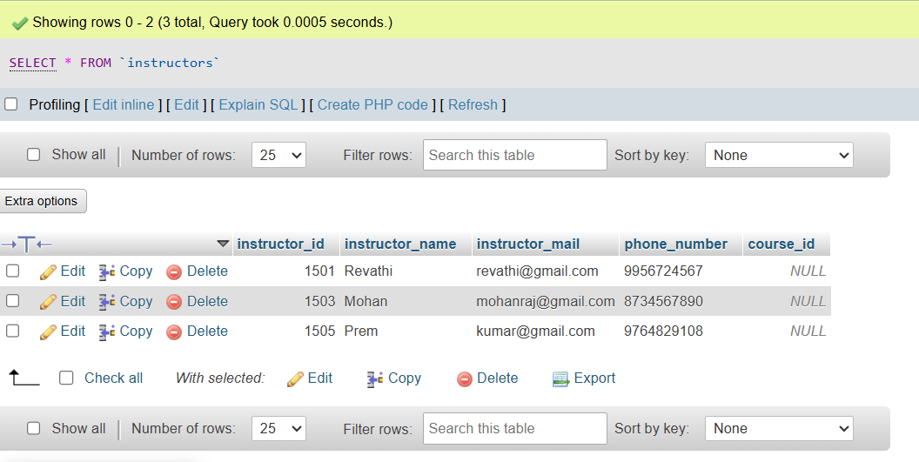
ADDING COLUMN
ALTER TABLE instructors
ADD COLUMN course_id INT;

Slide 11
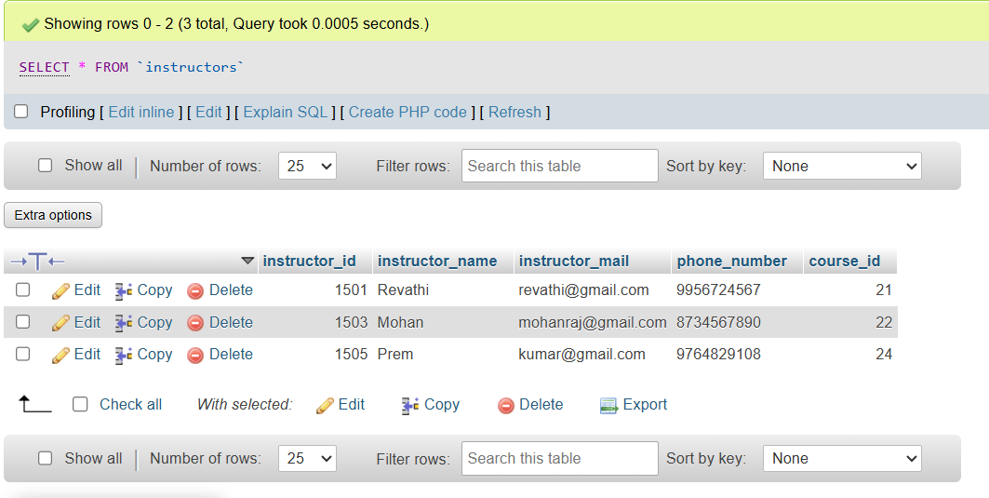
UPDATE
UPDATE instructors SET course_id = 21
WHERE instructor_id = 1501;
UPDATE instructors SET course_id = 22
WHERE instructor_id = 1503;
UPDATE instructors SET course_id = 24
WHERE instructor_id = 1505;

Slide 12
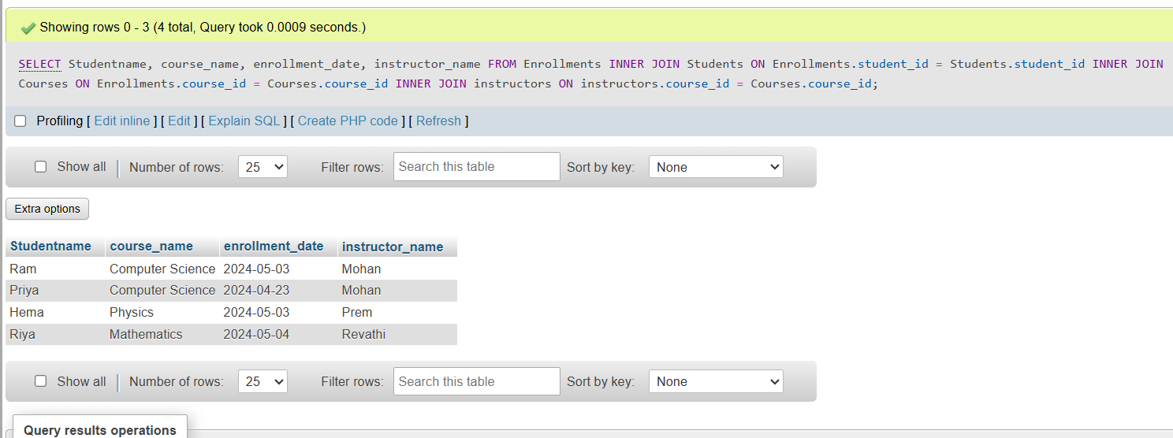
INNER JOIN
SELECT Studentname, course_name, enrollment_date, instructor_name
FROM Enrollments
INNER JOIN Students ON Enrollments.student_id = Students.student_id
INNER JOIN Courses ON Enrollments.course_id = Courses.course_id
INNER JOIN instructors ON instructors.course_id = Courses.course_id;

Slide 13
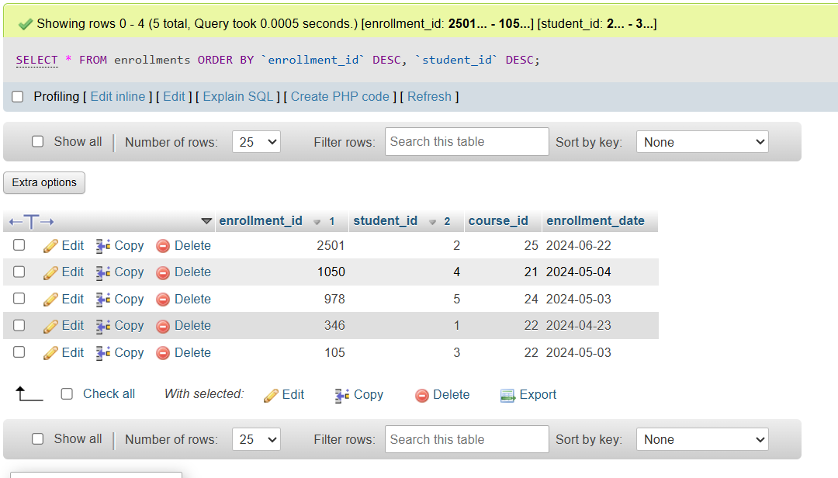
ARRANGING IN DESCENDING ORDER
SELECT * FROM enrollments ORDER BY `enrollment_id` DESC, `student_id` DESC

Slide 14
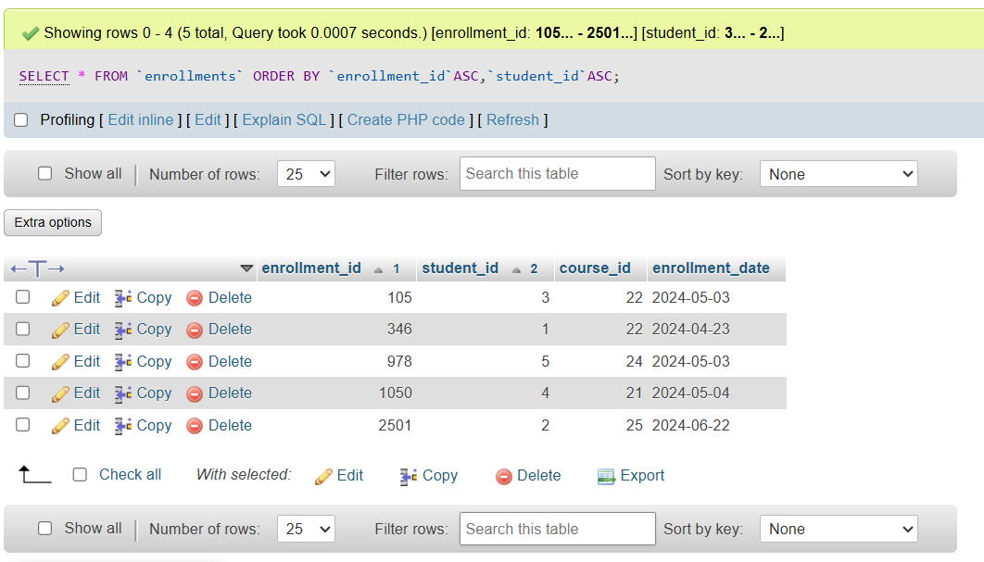
ARRANGING IN ASCENDING ORDER
SELECT * FROM `enrollments` ORDER BY `enrollment_id`ASC,`student_id`ASC;

Slide 15
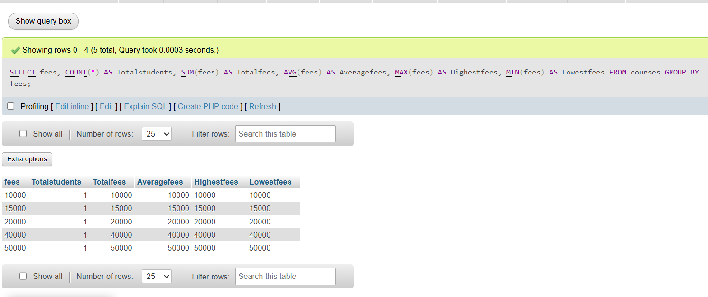
AGGREGATE FUNCTIONS
SELECT
fees,
COUNT(*) AS Totalstudents,
SUM(fees) AS Totalfees,
AVG(fees) AS Averagefees,
MAX(fees) AS Highestfees,
MIN(fees) AS Lowestfees
FROM courses
GROUP BY fees;

Slide 16
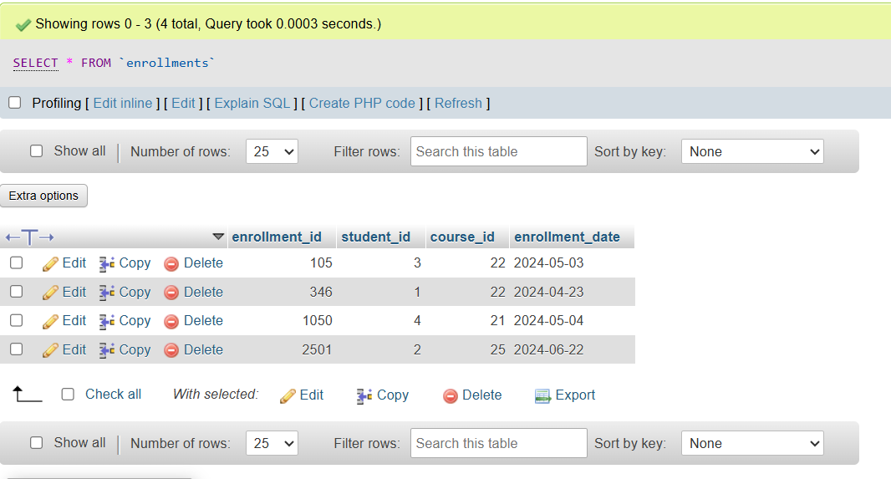
DELETE ROW
DELETE FROM `enrollments` WHERE `student_id`=5;

Slide 17
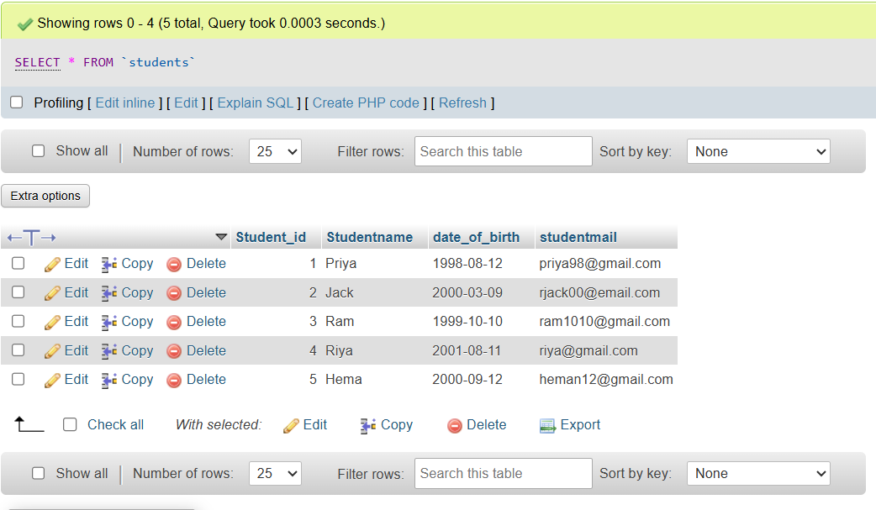
DELETE COLUMN
ALTER TABLE students
DROP COLUMN `enrollement_date`;

Slide 18
THANK YOU!

